Slide 1
Linear Regression

Slide 2
Contents
Definitions of Regression
Introduction to Linear Regression
Assumptions of Linear Regression
Fitting of Linear Regression Line
Properties of Best Fit Line
Fitting of Best Fit Line
Model Evaluation Parameters
Multiple Linear Regression

Slide 3
What is Regression
Regression in a process where we try to establish a relationship between Dependent variable and a set of Independent variables.
BMI = 10 + Weight*5 + Height*7
Here, we are trying to establish a relationship between Dependent variable(BMI) and Independent Variables(Weight and Height). So, for given Weight and Height we can predict value of BMI using above equation.

Slide 4
Linear Regression
Linear Regression is a process to regress the data with dependent variable having numerical values whereas independent variables can have either numerical or categorical values.
In other words “Linear Regression” is a method to predict dependent variable (Y) based on values of independent variables (X).
It can be used for the cases where we want to predict some continuous quantity. E.g., Predicting Sales in a Super store, Predicting Cost of Living Index of a city e.t.c.

Slide 5
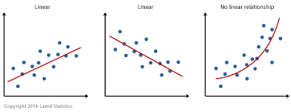
Assumptions in Linear Regression
Linearity:
Dependent and Independent variables should be linearly related. i.e.
If x increase/decrease by one unit, y should also increase/decrease by One unit.

Slide 6
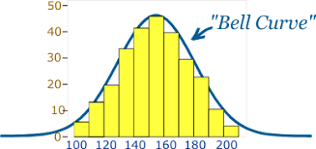
Cont….
Normality of Errors:
Residual errors should be
normally distributed.
Residual Error = Actual Error – Predicted Error

Slide 7
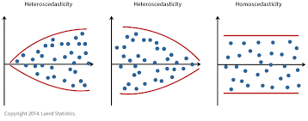
Cont….
Homoscedasticity:
Variance of Errors should be constant.

Slide 8
Cont….
No Multicollinearity.
Multicollinearity is defined as:
Relationship between independent variables.
So, in order for our Linear Regression model to preform better, there should not be any multicollinearity between independent variables.
For example:
Let’s say we have two independent variables x1 and x2 and dependent variable y.
If x1 and x2 have a strong relationship, then x1 will increase as x2 increases. So we cannot say, if our y is increasing because of x1 or x2.

Slide 9
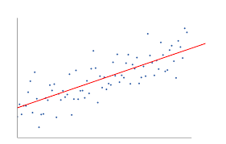
Linear Regression Line
The objective of Linear Regression is to fit a line in the distribution which is close to all the points.
By doing so, we try to reduce the residual
error.
Residual error is calculated as vertical
distance between each point and the line.
In the given figure each point represents a data point and the line
represents a Linear Regression line.

Slide 10
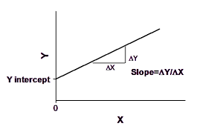
Cont….
Lets say : x is our independent variable and y is dependent variable.
Then above Line can be represented in the form of below equation:
Y = mx + c where
m = Slope of the line
c = intercept of the line

Slide 11
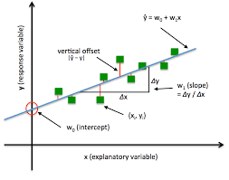
Properties of best fit line
The best fit line always passes through mean of dependent and independent variables.
The line always tries to minimize the sum of ‘Square of Residual’ errors. This method is known as Least square method.
Hence, Linear Regression works on Least Square
method.

Slide 12
Finding best fit line
Using any statistical tools like Excel, R, Python, we can easily calculate values of m(slope) and c(intercept) and fit the line.
But in the backend it works based on Least Square Method as discussed and tries to reduce Sum of Squared Errors.
Lets look at an example and calculate m and c for data in the next slide.

Slide 13
Cont….
x | y
1 | 3
2 | 4
3 | 6
4 | 8
5 | 10
Let’s consider the table given.
Std. deviation of x | 1.414214
Std. deviation of y | 2.56125
Mean if x | 3
Mean if y | 6.2
Correlation between x and y | 0.993884
Various statistical values for the data which we will be using to calculate m and c.

Slide 14
Cont….
If we differentiate the Residual Sum of Square (RSS) wrt. c & m and equate the results to zero, we get the following equations as a result:
m = Correlation * (Std. Dev. of y/ Std. Dev. of x)
c = Mean(Y) – m * Mean(X)
Putting values from table 1 into the above equations,
m = 1.8
c = 0.015665
Hence Regression equation will be:
y = 0.015665 + 1.8 * x

Slide 15
Cont….
x | y-actual | y-predicted
1 | 3 | 1.815665
2 | 4 | 3.615665
3 | 6 | 5.415665
4 | 8 | 7.215665
5 | 10 | 9.015665
Given small number of data points, predicted values are not as accurate as we would have liked.
But if we check correlation between y-actual and y-predicted, it turns out to be very high, and hence both values are moving together as shown in the graph.

Slide 16
Model Evaluation
Once we build our model, next step is to test performance of our model.
To test this, there are various parameters we can study.
R – Square (R²)
Adjusted R-Square(R²⁾
Root Mean Square Error (RMSE)
Mean Absolute Percentage Error (MAPE)

Slide 17
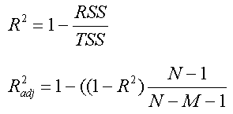
R – Square (R²)
R² is calculated using formula:
Where:
TSS – Amount of variance in the Response/Dependent variable before Regression is performed.
RSS – Amount of variance that is left unexplained after performing regression
(TSS-RSS) will give us the variance explained by the model.
R² value ranges from 0 to 1
R² value of 0 means that we cannot predict dependent variable from independent variable
R² value of 1 means that we can predict dependent variable from independent variable without any error.
R² value of 0.8 means that we can predict dependent variable from independent variables with 80% accuracy.

Slide 18
Adjusted R²
The drawback of R² is that as we keep on adding independent variables to our model, R-square either increases or keeps constant, but never decreases. So, we cannot come to conclusion that by adding more predictors to our variable, we are making our model more accurate.
To overcome this problem we calculate Adjusted R².
Adjusted R² penalizes for addition of any insignificant predictors to our model.
It’s value decreases if we add any insignificant variables to our model.

Slide 19
Cont….
It is calculated using the formula :
Where:
N = Total Sample Size.
M = Number of Predictors.

Slide 20
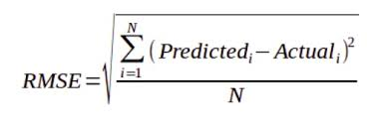
Root Mean Square Error (RMSE)
RMSE gives us the measure of dispersion of predicted values from actual values.
It is calculated using the formula:
Where: N = Total number of observations.
Major drawback of RMSE is, the value is susceptible to range of our dependent variable, i.e if range of dependent variable is more, RMSE can be more. If range is less, RMSE can be less. So we are not quite sure what is optimal RMSE could be.
However RMSE can be a good metric to compare between different iterations of a model.

Slide 21

Mean Absolute Percentage Error(MAPE)
In order to overcome limitation of RMSE, MAPE can be used as an evaluation parameter.
It gives us the error in terms of percentage, hence can be used across models.
It is calculated using the formula:
Where N – Number of observations.

Slide 22
Multiple Linear Regression
Till now we saw Simple Linear Regression where we had only one Independent Variable.
If number of independent variables is more than one, the process of fitting the line is known as Multiple Linear Regression.
Like Simple linear regression, Multiple linear regression also works on Least Square Method.
In case of Multiple linear regression, the equation of the line can be modified as:

Slide 23
Cont….
Equation:
y = m1x1 + m2x2 + m3x3 + ……………mnxn + c
Where:
xi – dependent variables
mi – coefficients for different variables.
c - intercept

